Slide 1

SHRP2 and Every Day Counts Products
September 9, 2015
David Otte - KYTC
Jason J. Siwula, PE – KYTC

Slide 2
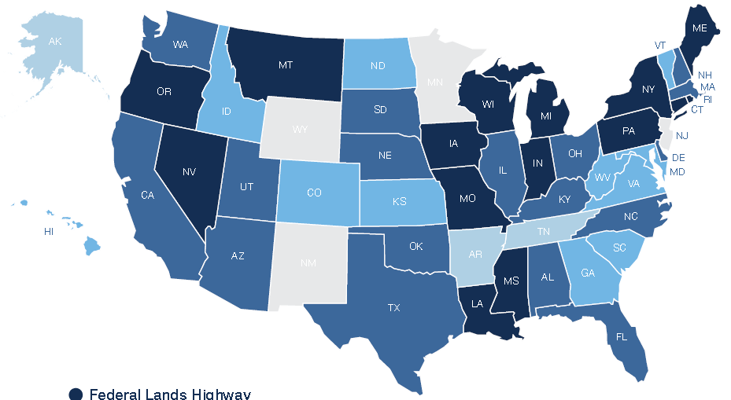
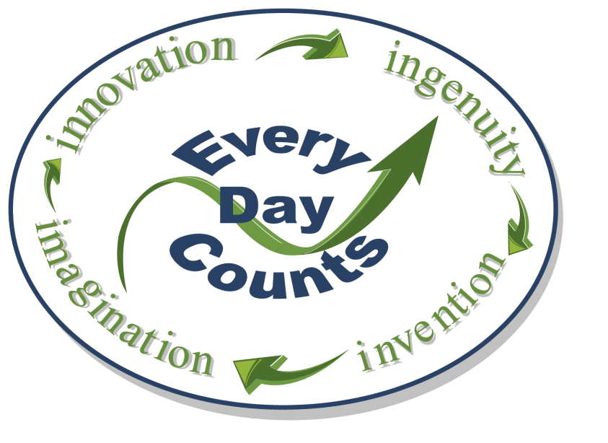
What is “Every Day Counts”?
Stakeholder-based model to identify and rapidly deploy proven innovations
Notes:
EDC is a stakeholder-based model to identify and rapidly deploy proven, but underutilized innovations.
In developing the EDC initiative, the FHWA recognized that State DOTs serve as innovation leaders for their States and, by partnering with local agencies and industry stakeholders, they play a pivotal role in innovation deployment.
As such, EDC is a stakeholder-based model whereby States select the innovations which best fit the unique needs of the highway community with the State and then work to quickly put those innovations into practice.

Slide 3




What is SHRP2?
Strategic Highway Research Program 2
A federal highway research initiative encompassing:
  Safety
  Renewal
  Reliability
  Capacity
Total funding - $232.5 million through March 2015

Slide 4
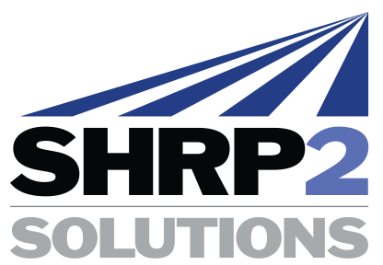

SHRP 2 –EDC Relationship
Purpose - Advancing effective, proven and market-ready technologies into widespread use
Other Research Products
Other Proven Innovations
Notes:
EDC is not about inventing the next "big thing".
It's about taking effective, proven and market-ready technologies and getting them into widespread use. These innovations could come from SHRP2, the AASHTO Innovation Initiative, or other sources.
As an EDC innovation more emphasis and resources are provided to get them into every day use.
Proven innovations and enhanced business processes promoted through EDC facilitate greater efficiency at the state and local levels, saving time and resources that can be used to deliver more projects for the same money. Better-Faster-Smarter.

Slide 5


SHRP2 Implementation Assistance Program
Goals – Deployment of SHRP2 Solutions and encourage early adoption of SHRP2 products
The Implementation Assistance Program (IAP) is available to help:
  State Transportation Agencies
  Metropolitan Planning Organizations
  Tribal Governments
  Other interested organizations

Slide 6
SHRP2 IAP
Three levels of assistance available
  Proof of Concept Pilot – Offers highway agencies to evaluate the readiness of a product, and to gain more experience in the use of a product
  Lead Adopter Incentive – Provides assistance to organizations to be a lead adopter of a product in the US.
  User Incentive – Provides assistance to organizations who have interest in a product, but may not wish to participate as a Lead Adopter

Slide 7
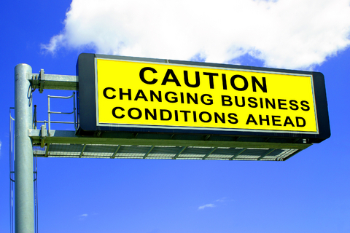
Infrastructure condition
Resource constraints
Public expectations
More complex transportation system
Technology advancements
Notes:
For the past several years, transportation agencies have been facing a growing list of infrastructure needs while funding sources and other resources are declining.
Public awareness and expectations for performance of the system are higher than ever before.
Our transportation system has become more complex – multimodal considerations, managed lanes, freight concerns, etc.
Population growth will drive an increase in total travel and an increased amount of freight needing to be moved.
The size and age of the population will increase demand for public safety and mobility.
A more diverse population will result in different travel patterns and travel needs.
Policymakers have long questioned why it takes so long to deliver projects.
Although this serves as both a challenge and an opportunity, technology affecting all aspects of our lives continues to advance at a rapid pace.

Slide 8

Why “Every Day Counts”?
Changing conditions and demand for more efficient project delivery
Technology deployment and transfer are core FHWA roles
Provide a mechanism for rapid deployment of proven innovation
Create a sense of urgency
Notes:
These changes and the challenges each pose require that the highway community look for better ways of doing business to stretch our transportation dollars and improve efficiency to deliver highway projects faster.
To keep pace with the changing times, we wanted to get innovations into practice that would: Shorten the project delivery process; Enhance safety; Reduce congestion; and Improve environmental sustainability.
Leadership in technology transfer and innovation deployment has been a fixture of the FHWA since its origination in 1893 as the Office of Road Inquiry.
Although the highway community has a long history of conducting research to find better solutions and processes, we also have a history of being slow to change and sticking with the way we have always done things.
To build on our legacy of technology transfer and create a sense of urgency, the FHWA launched the Every Day Counts (EDC) initiative in cooperation with AASHTO to do just that.
The name “Every Day Counts” was chosen to capture the driving public’s urgent need for transportation facilities delivered better, faster and smarter.

Slide 9
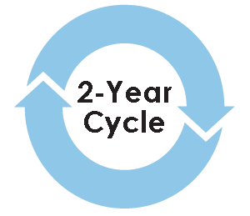

How EDC Works
Stakeholder collaboration to identify and select innovations
Establish multidisciplinary deployment teams
  Draft implementation plans
  Compile resources
  Assemble case studies
  Prepare training
Notes:
Through the EDC model, FHWA works with state and local transportation agencies and industry stakeholders to identify a new collection of a dozen or so innovations to champion every two years.
Innovations are selected collaboratively by stakeholders, taking into consideration of market readiness, impacts, benefits and ease of adoption of the innovation.
After selecting the EDC technologies for deployment, FHWA assembles multi-disciplinary technical teams to lead deployment efforts. The deployment teams work to draft implementation plans, compile resources, assemble case studies, and prepare training to educate stakeholders on the selected innovations and ultimately assist in implementation and adoption of the selected innovations.

Slide 10
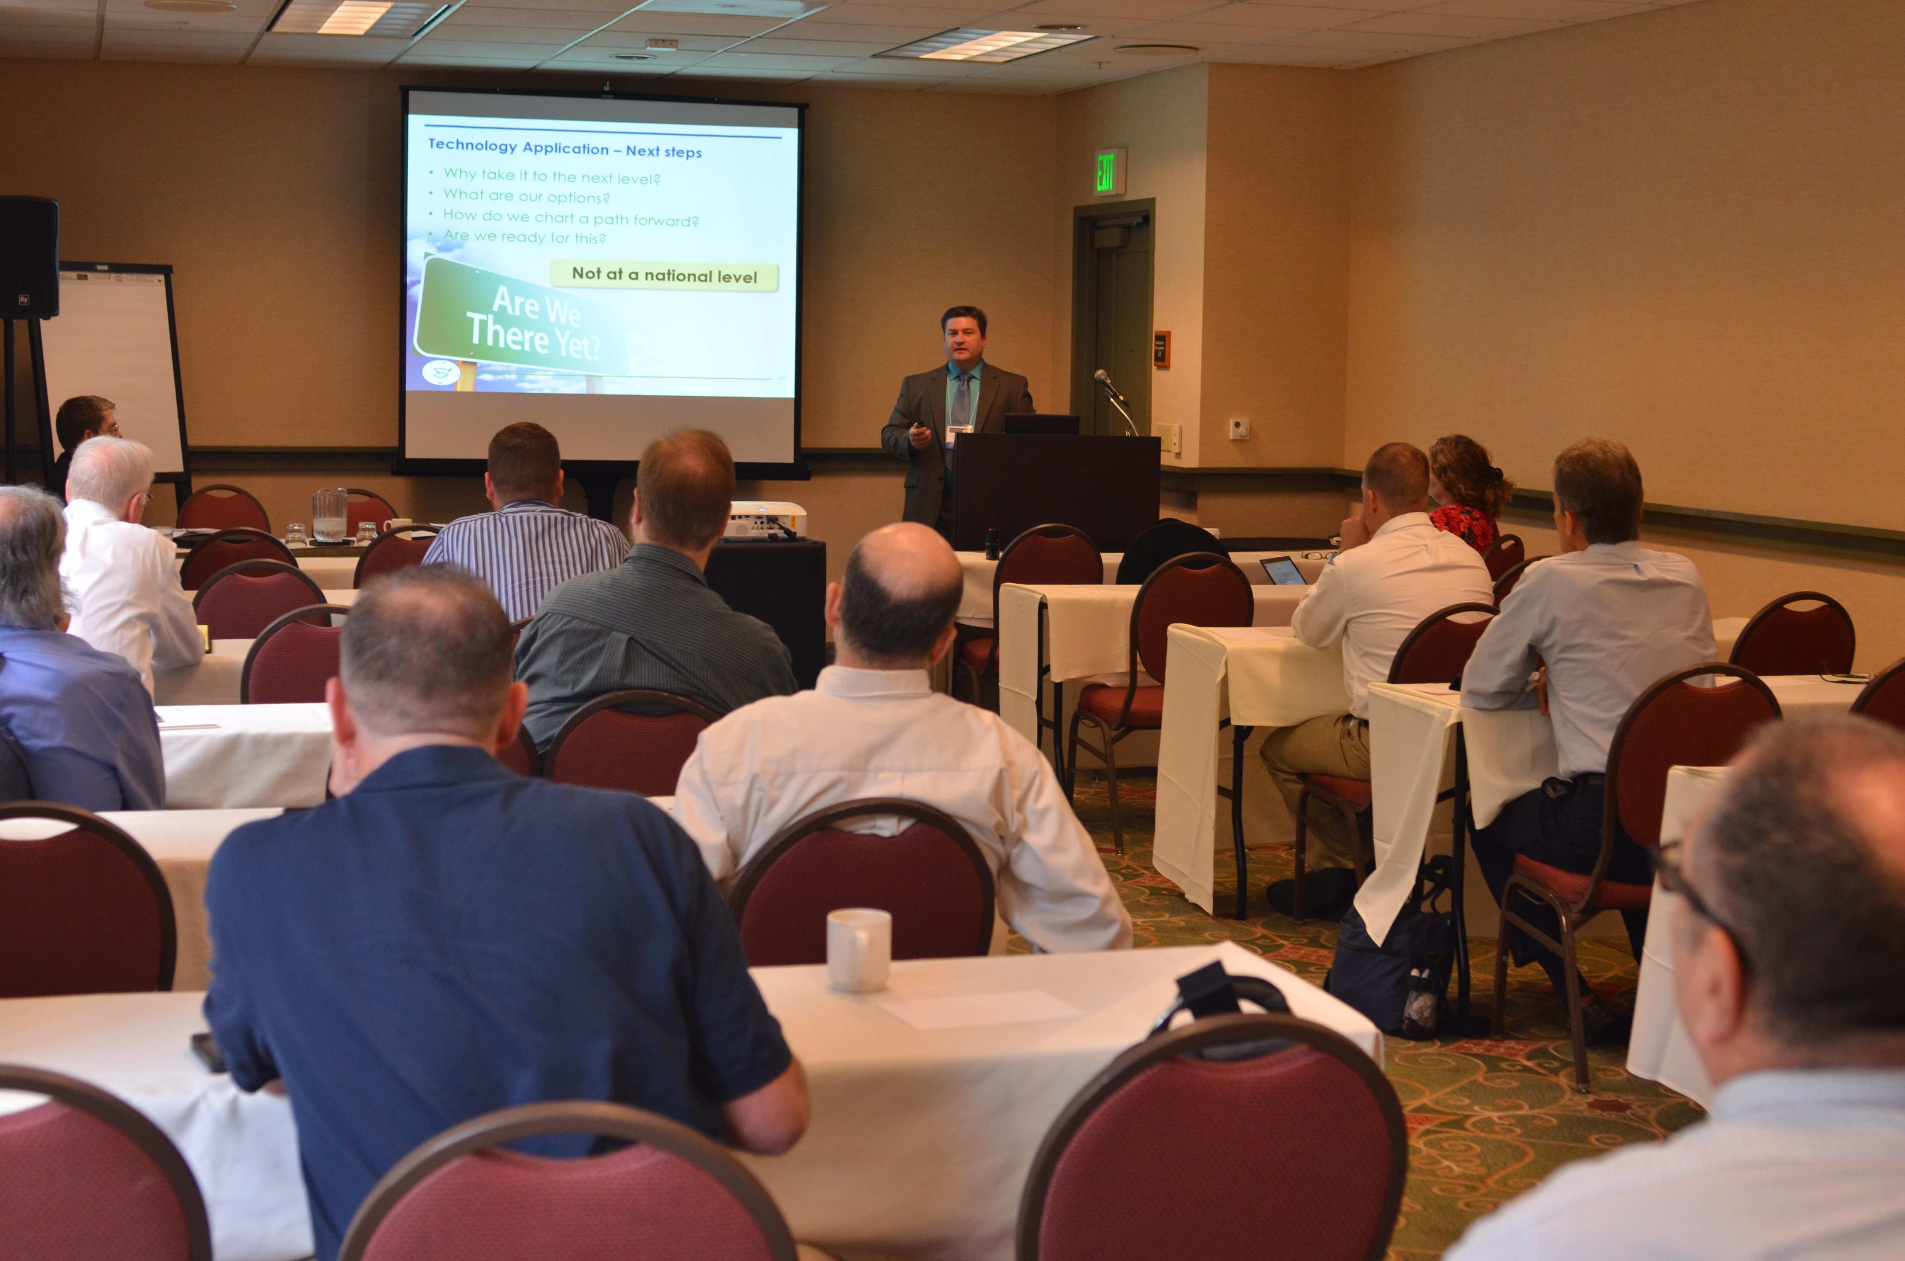
How EDC Works (Cont.)
Conduct regional summits for transportation stakeholders to:
  Learn about selected innovations
  Share best practices among neighboring states
  Provide feedback on implementation strategies and resource needs
  Initiate discussions on which innovations meet the unique needs of of each state
Notes:
After the deployment teams are established and have developed initial implementation plans and resources, transportation leaders from across the country gather at regional summits to discuss the selected innovations and share best practices. Stakeholders attending the summit also provide feedback to the FHWA deployment teams on the proposed implementation strategies and resources agencies will need to adopt or deploy each innovation.
These summits begin the process for states, local public agencies and Federal Lands Highway Divisions to focus on the innovations that make the most sense for their unique program needs, establish performance goals and commit to finding opportunities to get those innovations into practice over the next two years.

Slide 11
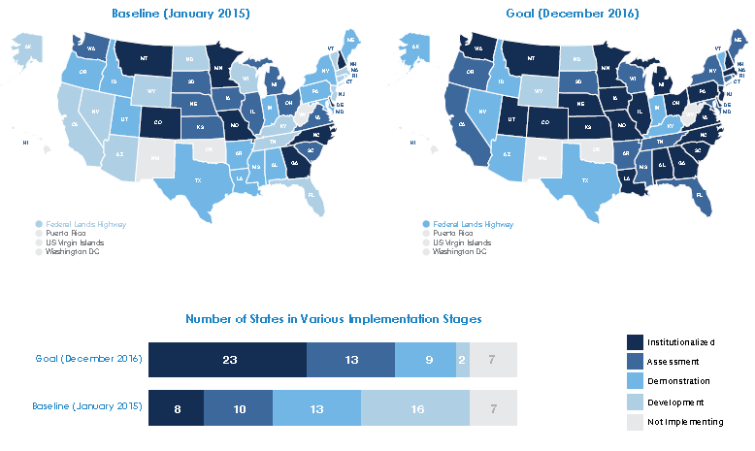
How EDC Works (Cont.)
States select innovations for deployment and establish goals for level of implementation
Notes:
After learning about the innovations and reviewing them in state caucuses at the summits, participants take their recommendations back to their states for further discussion and development of plans for implementation over the next two years. In general, State Transportation Innovation Councils (STICs) evaluate and choose innovations that fit the state’s needs and oversee deployment efforts in the state.
To start the process of tracking progress on innovation deployment, FHWA’s EDC coordinators in each state gather information on the current stage of implementation for each innovation at the beginning of EDC cycle and the implementation stage goal the state plans to achieve by the time the two-year cycle ends.
Every six months, FHWA will update the status of the state of practice on the innovations.

Slide 12
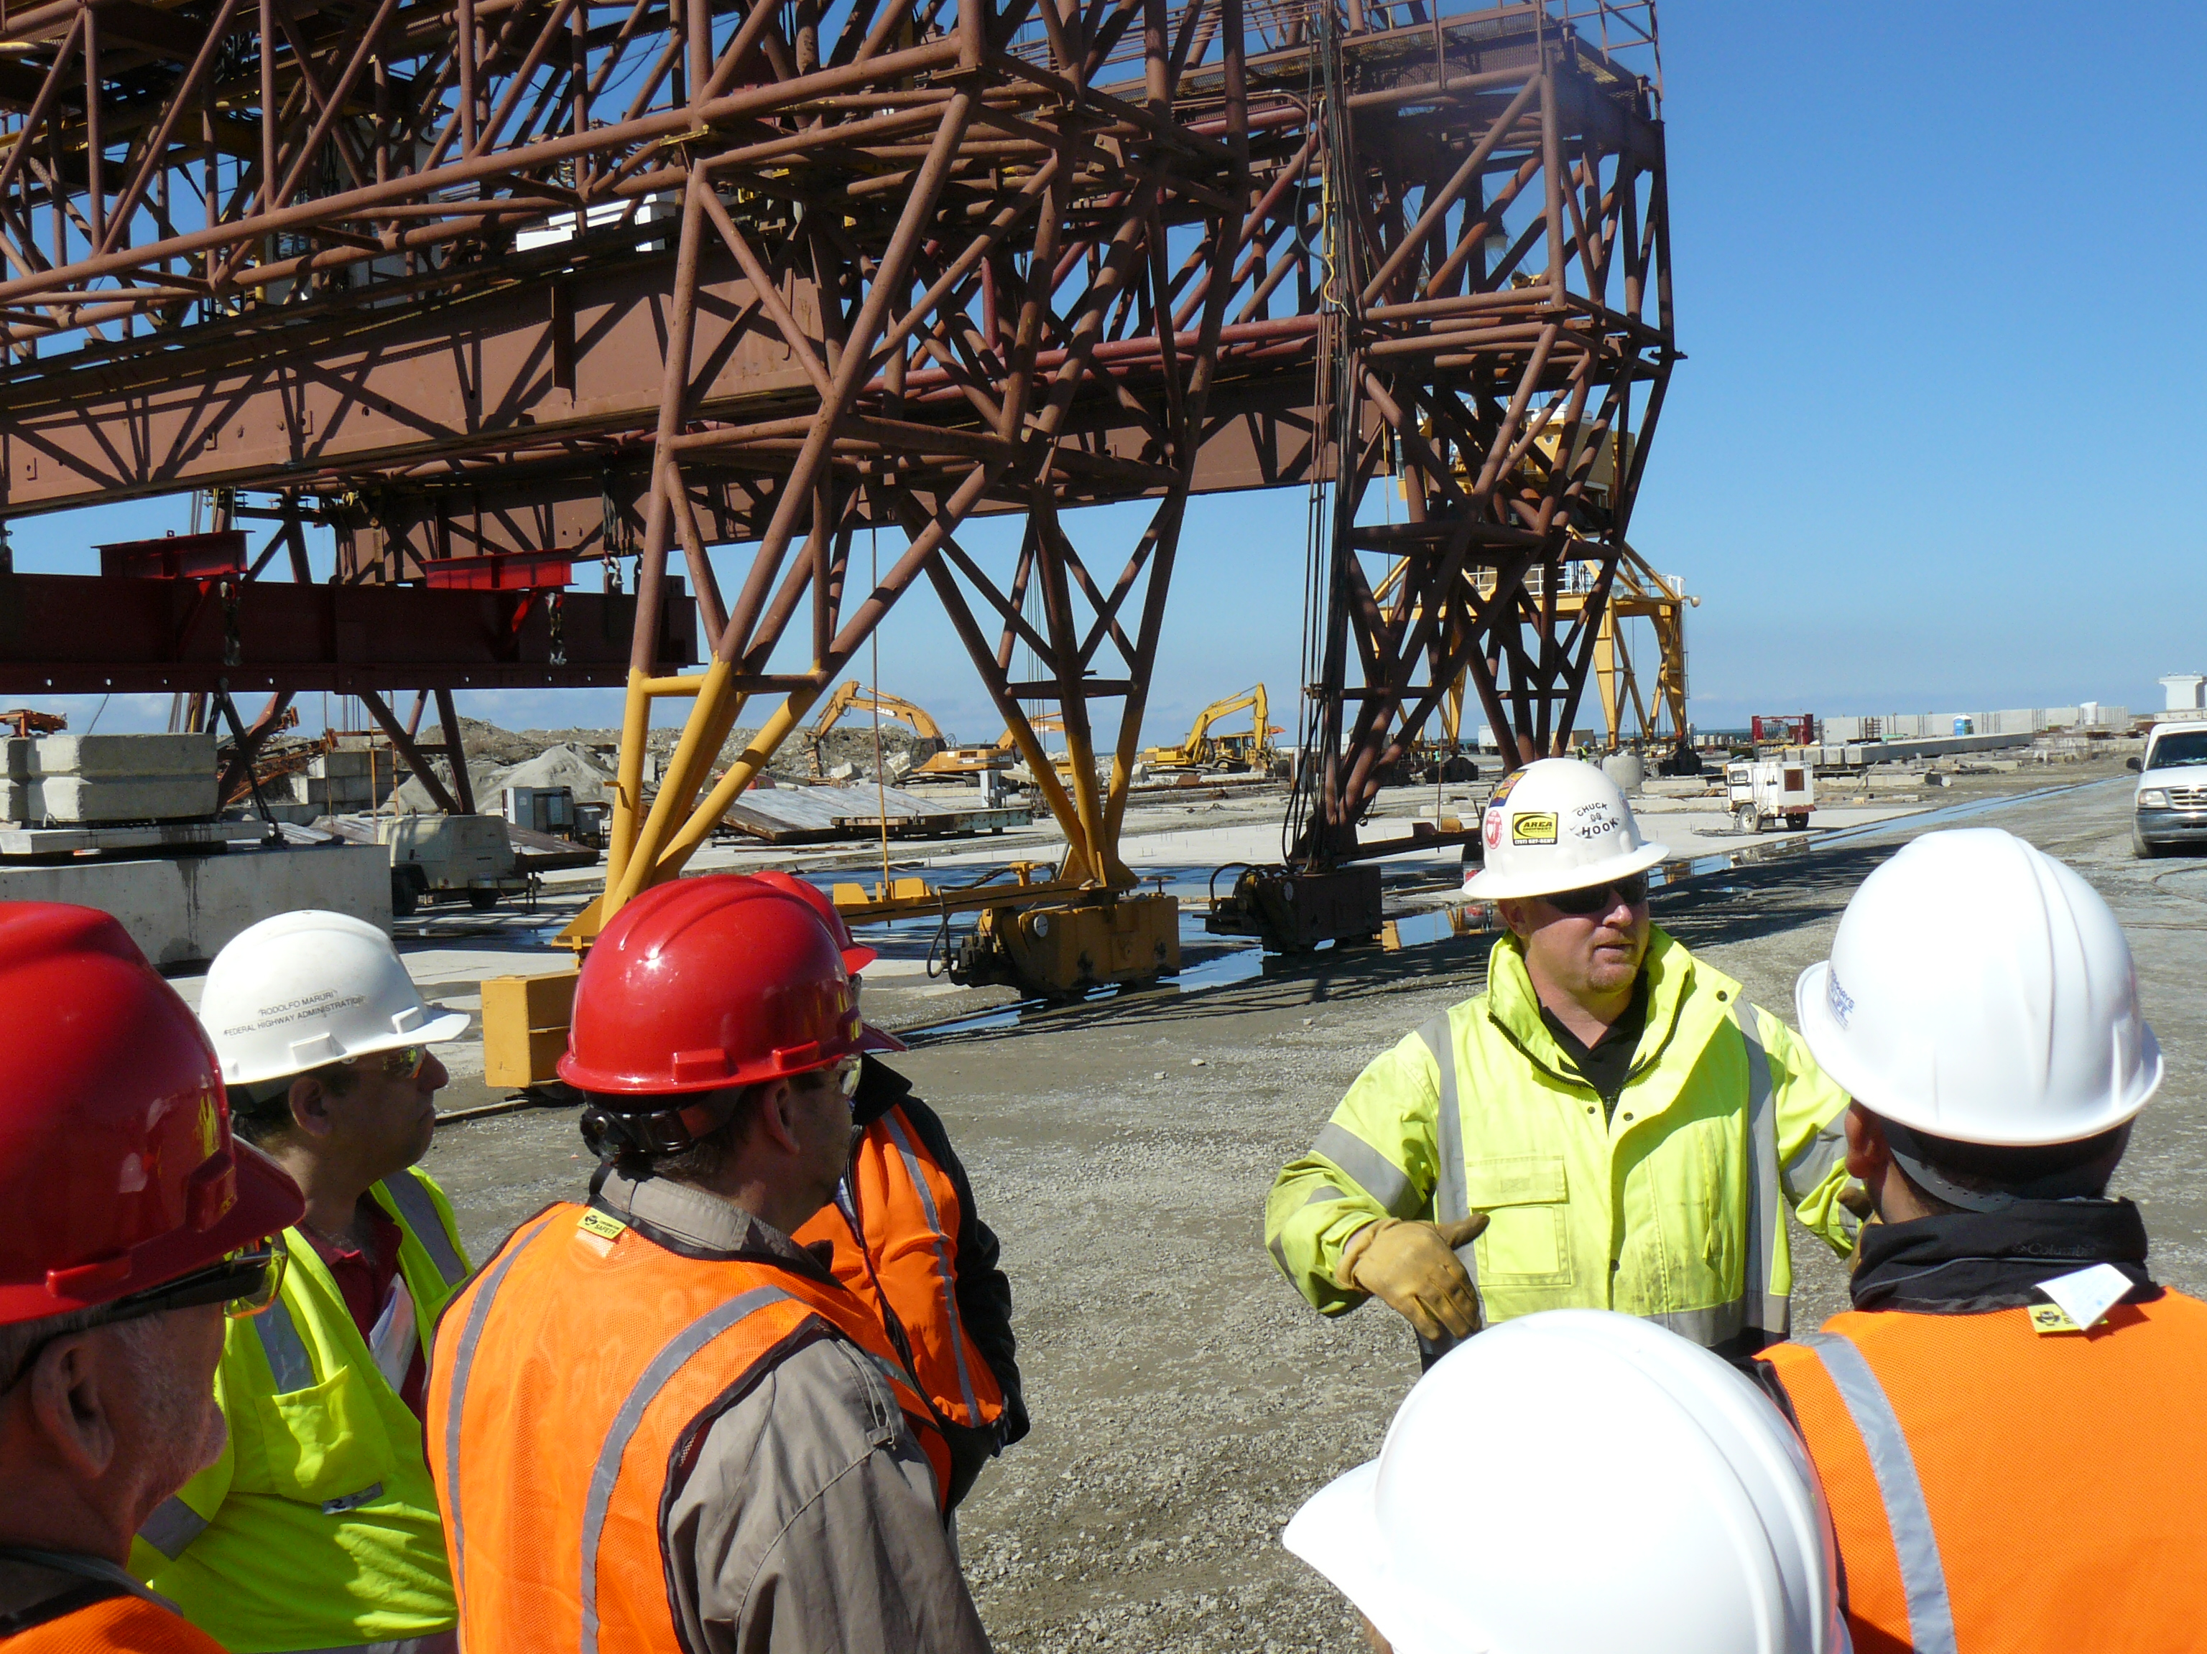
How EDC Works (Cont.)
Multidisciplinary deployment teams:
Finalize implementation plans
Provide technical assistance and support:
  Training
  Webinars and workshops
  Demonstrations and peer exchanges
  Case studies
  Guidance and specifications
Notes:
Throughout the two-year deployment cycle, deployment teams provide technical assistance to help transportation stakeholders deploy the selected innovations.
The assistance includes training sessions, briefings, webinars, workshops, and peer exchanges that enable stakeholders to become knowledgeable about the innovations.
The technical teams also develop guidance documents, specifications where applicable, and coordinate events to demonstrate the innovations on actual projects for stakeholders to observe and learn from the success and challenges of others’ implementation efforts.
Additionally, the FHWA tracks and reports on the national state of practice of each innovation and the successes achieved by States and local public agencies.

Slide 13

How EDC Works (Cont.)
Funding incentive programs:
State Transportation Innovation Council (STIC) Incentive Program
  Up to $100,000 available to each STIC per year
  Fund activities that have a statewide impact on making an innovation a standard practice
Accelerated Innovation Deployment (AID) Demonstration Program
  Incentive funding (up to a maximum of $1,000,000) to offset risk of using an innovation on a project

Slide 14
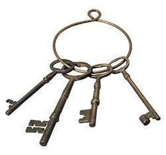
Keys to Success
Structured, stakeholder-based process
Broad stakeholder engagement
Selecting small set of technologies
Multiple communication mechanisms
Urgency (two-year cycle)
Setting goals – tracking performance
Resources (technical and financial)
Leadership
Notes:
EDC utilizes a structured process that brings national attention to innovation, elevates the conversation to decision-makers and provides technical support to overcome any barriers to implementation.
Innovation is local - State DOTs serve as innovation leaders for their States and, by partnering with local agencies and industry stakeholders, they play a pivotal role in innovation deployment so the approach must be stakeholder driven.
Stakeholders are actively engaged throughout the entire process from selection through deployment.
Stakeholder input is essential to ensure the innovations are market-ready and there is buy-in and support for deployment.
Limiting to a small set of innovations is key to be able to focus resources and achieve measurable results.
Promotion of the innovations and providing support for deployment activities through multiple communication mechanisms is essential.
The two-year cycle provides a sense of urgency and setting performance goals increases accountability to advance innovations.
Resources such as technical assistance and funding help stakeholders overcome barriers to advance innovations. The top-down and bottom-up engagement and support of highway stakeholders raises awareness of the various innovations and increases the knowledge base to support implementation.
Lastly, visible and engaged leadership is a must. Natural resistance to change can be minimized when leadership supports and encourages innovation.
The result is rapid technology transfer and accelerated deployment of innovation across the nation.

Slide 15
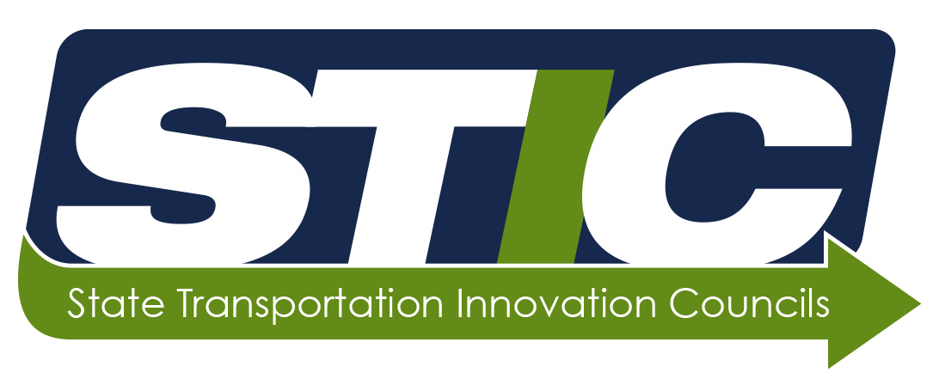
Significant Impacts of EDC
Creating an Innovation Culture:
  Established national innovation deployment network of 47 STICs
  STICs not just for EDC
Accelerating Innovation Deployment:
  Since EDC’s inception, every State DOT has used eight or more of the innovations promoted under EDC
Notes:
The EDC initiative has resulted in making broad impacts in:
Creating a culture of innovation within the highway community
A key component to institutionalizing this culture of innovation was the use of the state-based approach and development of the State Transportation Innovation Council (STIC) model.
The STIC concept is about establishing a group of representatives from various levels of the highway community in each State to comprehensively and strategically consider all sources of innovation.
The STIC model puts the State in the driver’s seat to select the innovations that best fit the State’s unique needs and approaches and then get those innovations into practice quickly.
A formalized council or equivalent forum affirms a State’s commitment to identify and institutionalize innovations, ensuring innovation deployment will continue as a business practice for years to come.
With a STIC or equivalent forum established in nearly every State (46 formal STICs established to date), we now have a national network to exchange best practices, technologies, and innovations and get them into widespread use across the nation.
Accelerating the deployment of innovations across the country
Since EDC’s inception, every state transportation agency has used eight or more of the innovations promoted under the initiative, and some have adopted over twenty.
Along with these innovations come the resulting benefits toward shortening project delivery, enhancing safety, reducing congestion, and improving environmental sustainability.

Slide 16
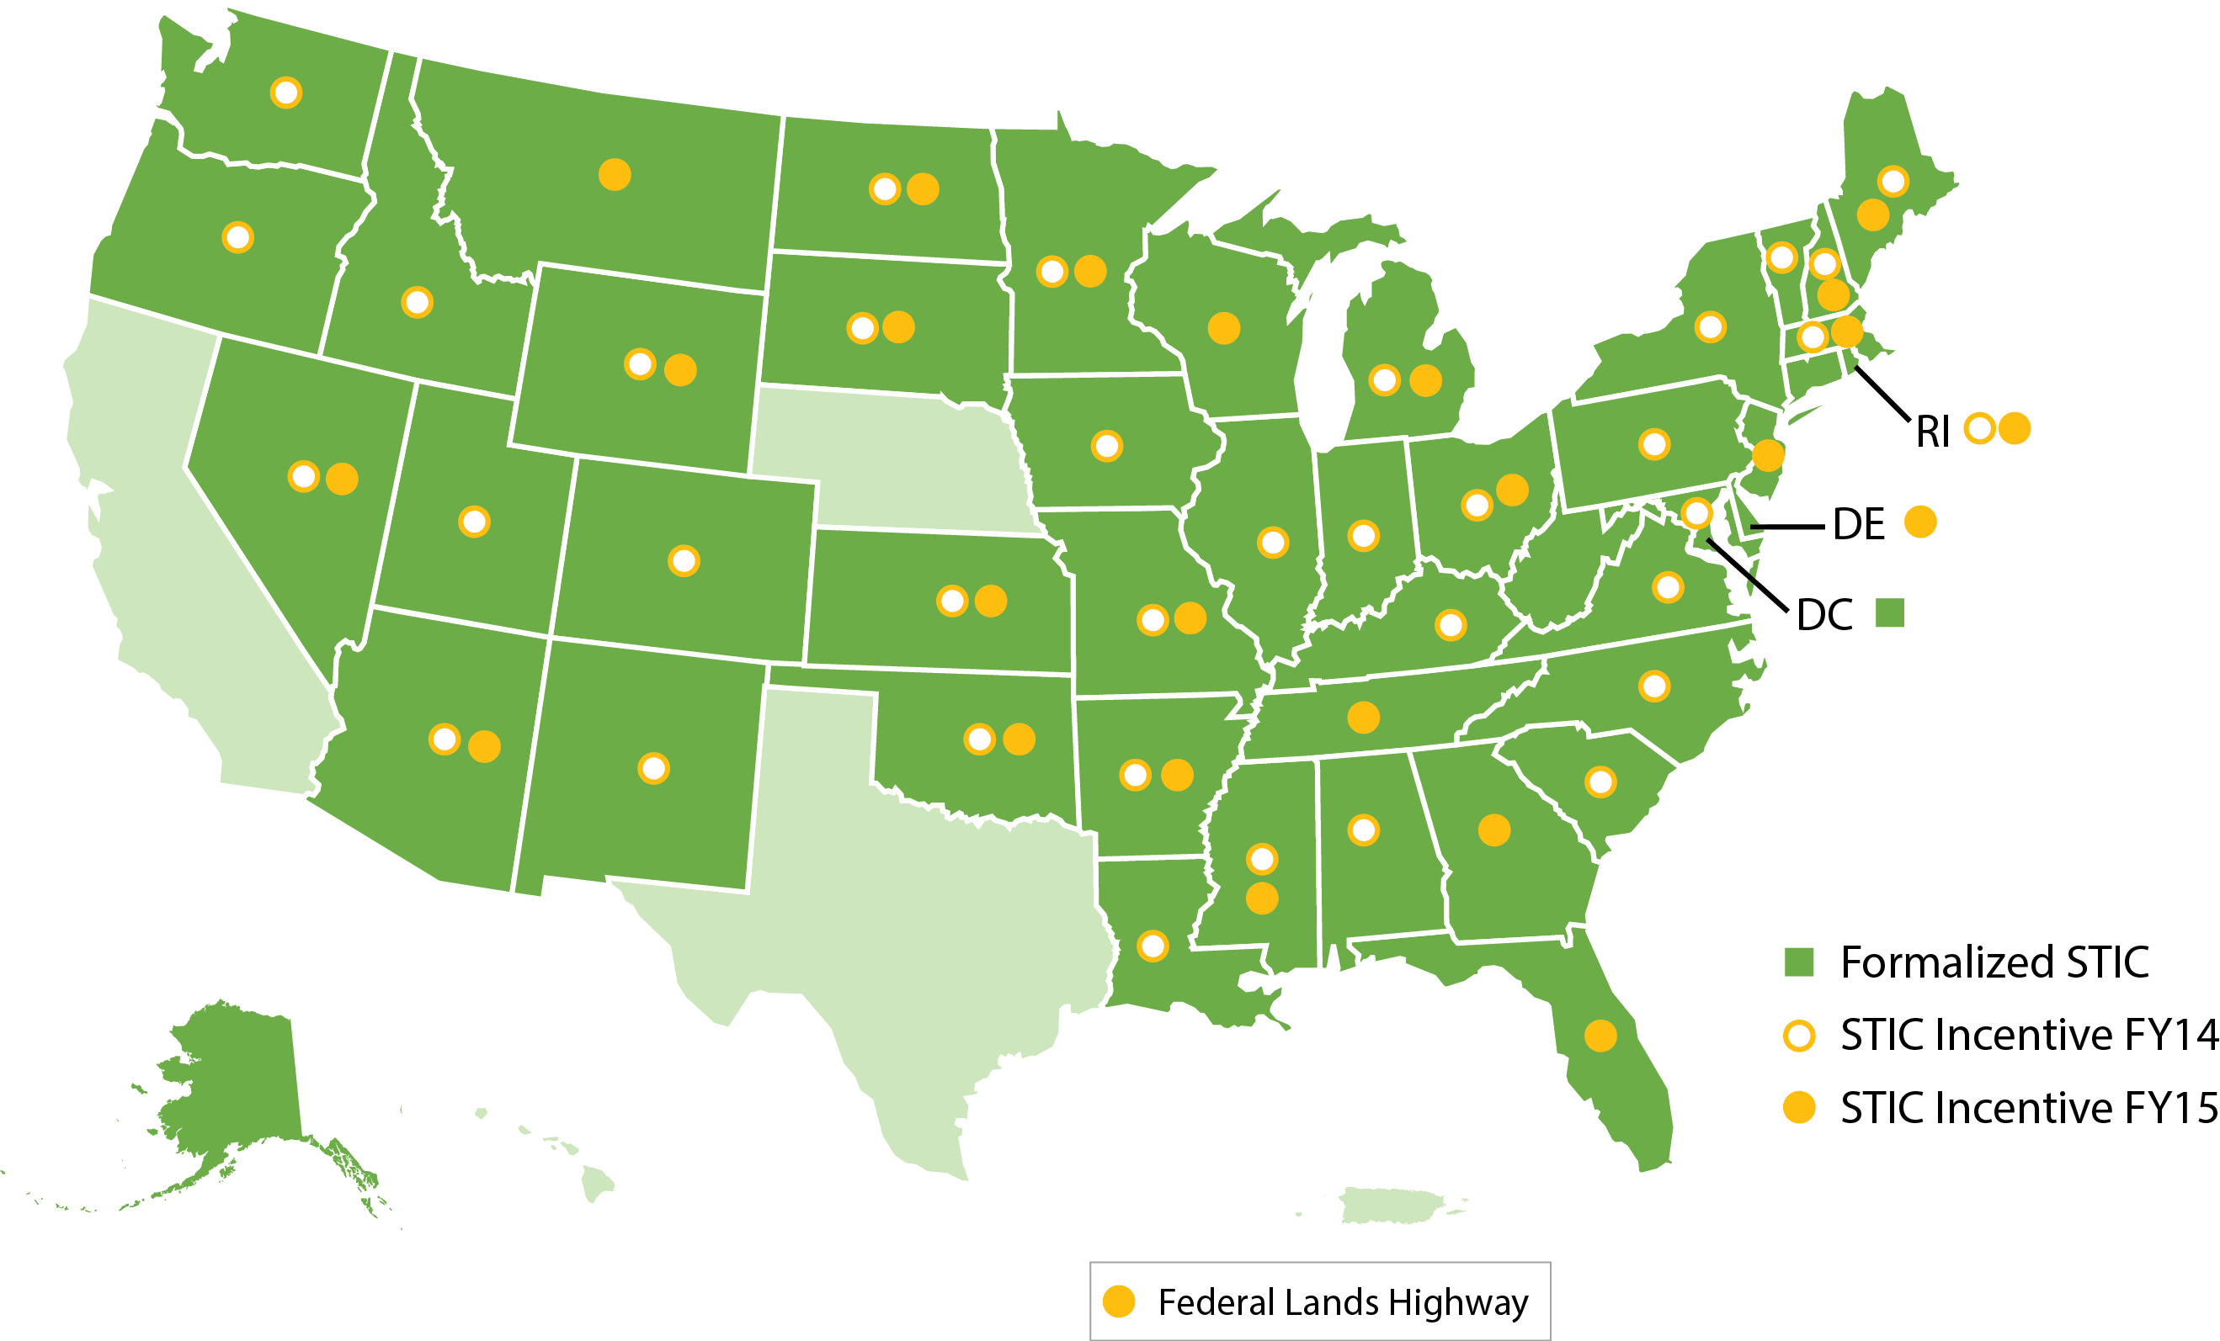
STIC Incentive Program (Sept. 1, 2015)
Allocations:
FY14: 36 STICs $3,517,420
FY15: 26 STICs $2,428,144
47 STICs
National Network

Slide 17
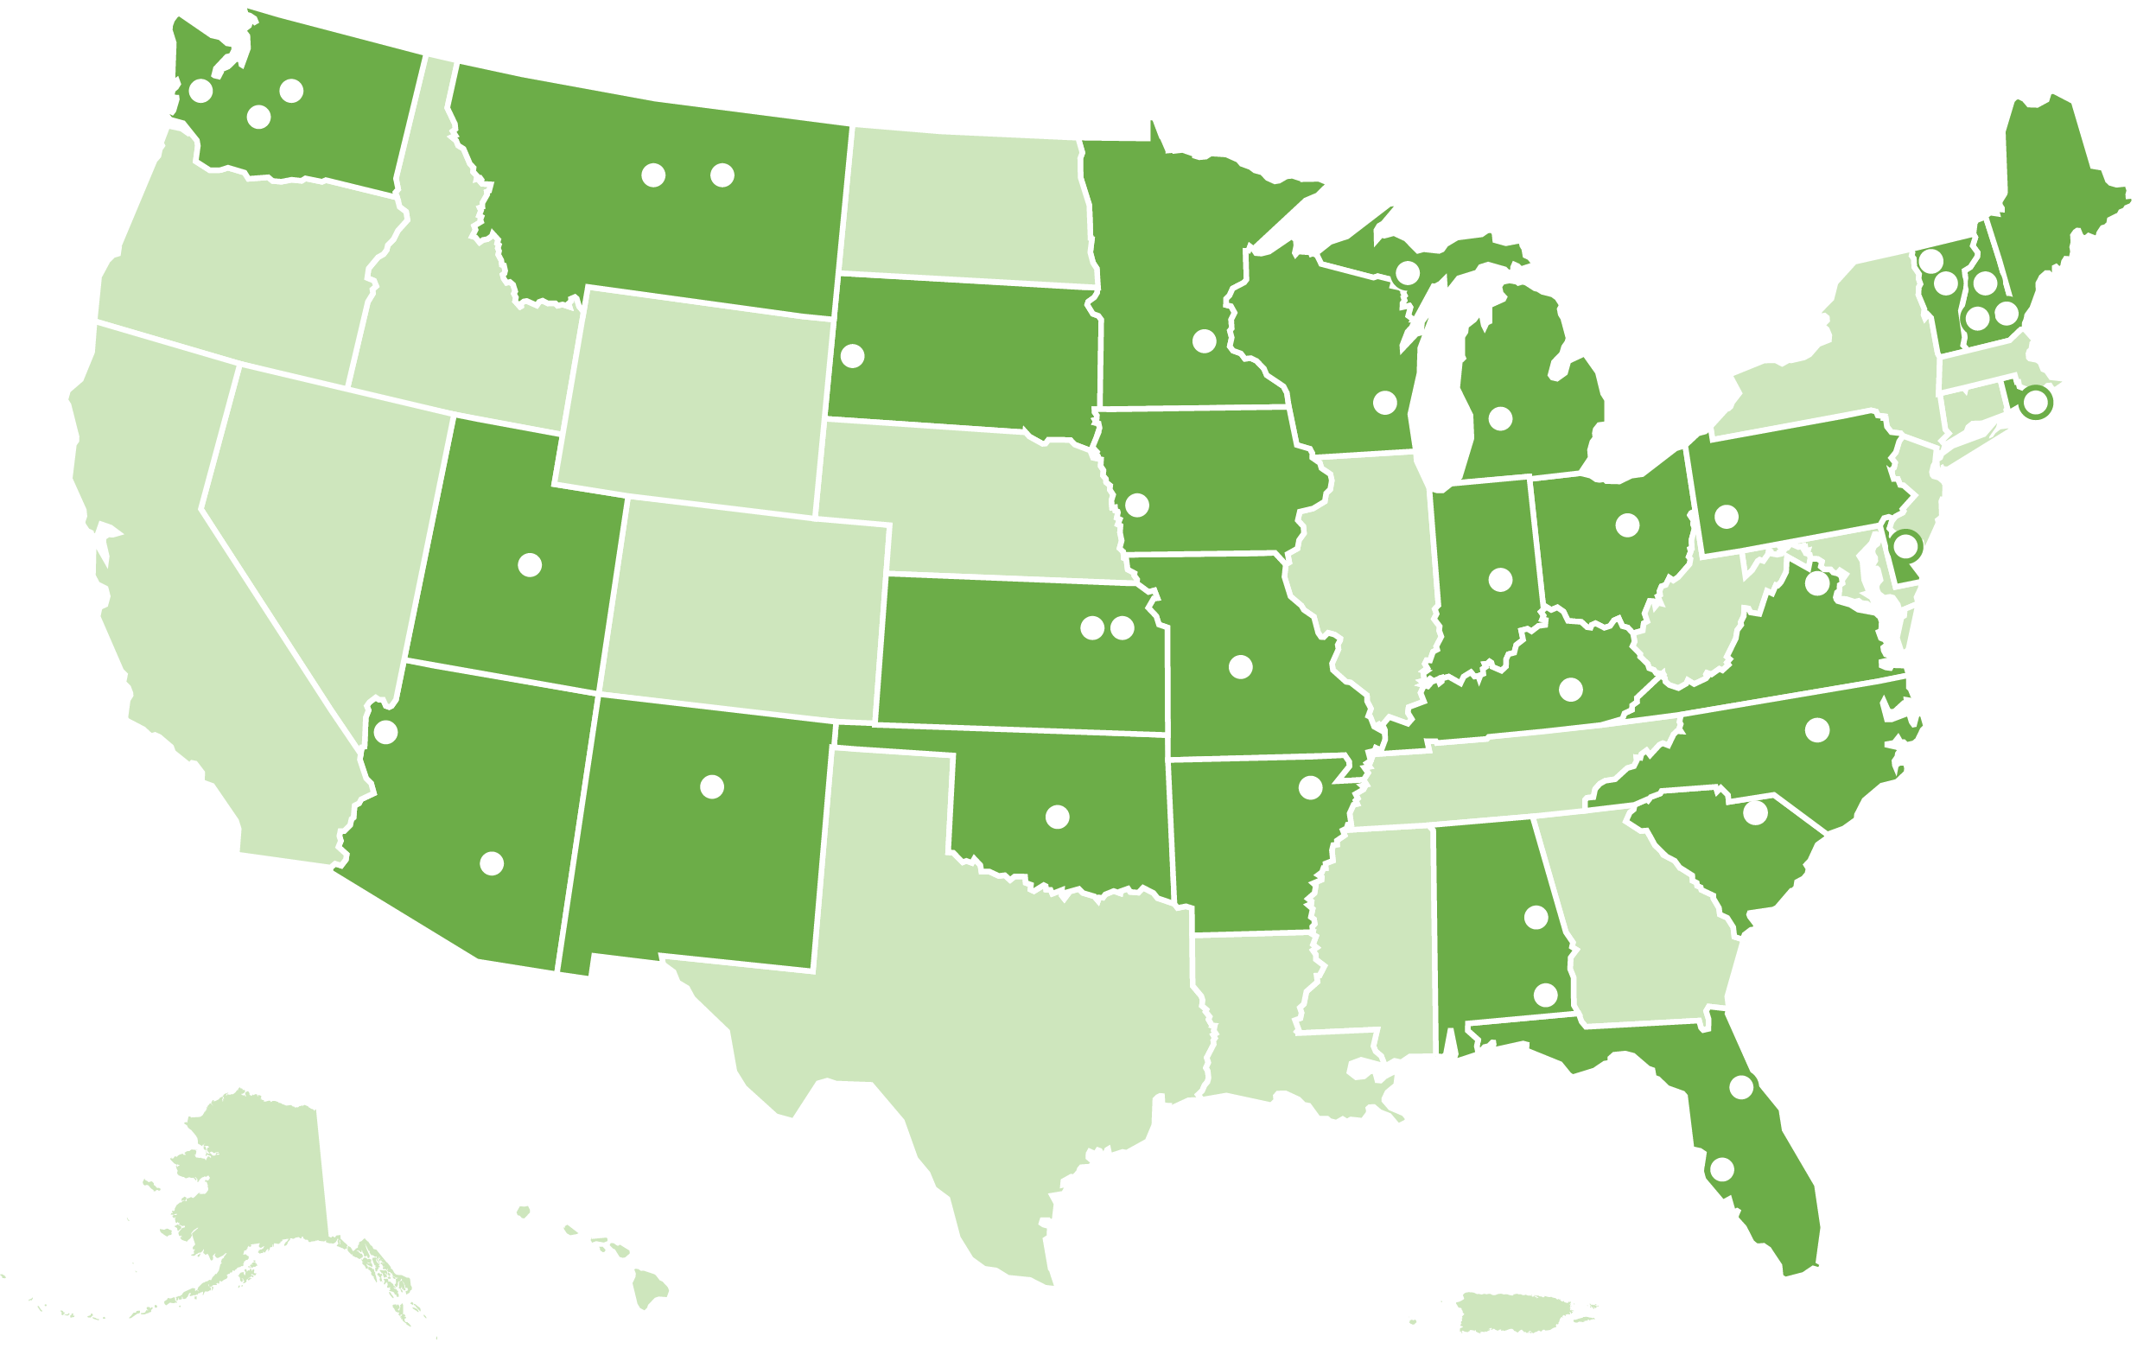
AID Demonstration Awards (Sept. 1, 2015)
Awards
FY14: 28
FY15: 13
Since Feb 2014: $30,396,727 awarded to
State DOTs, locals, tribes, and FLMAs

Slide 18
Why Innovation at KYTC?
KYTC Mission:
To provide a safe, efficient, environmentally sound and fiscally responsible transportation system that delivers economic opportunity and enhances the quality of life in Kentucky.

Slide 19
Why Innovation at KYTC?
KYTC Mission:
To provide a safe, efficient, environmentally sound and fiscally responsible transportation system that delivers economic opportunity and enhances the quality of life in Kentucky.

Slide 20
Why Innovation at KYTC?
KYTC Mission:
To provide a safe, efficient, environmentally sound and fiscally responsible transportation system that delivers economic opportunity and enhances the quality of life in Kentucky.

Slide 21
SHRP 2 and Every Day Counts Products
R15B – Identifying and Managing Utility Conflicts
STIC (State Transportation Innovation Councils)
R16 - Railroad – DOT Mitigation Strategies
RO1A – 3D Utility Location Data Repository

Slide 22
R15B Research
Challenge
When it comes to designing and implementing transportation projects, utility conflicts identified at the end of the design period or during construction can extend construction time, pose safety concerns, and increase costs. Locating, protecting, and relocating underground utilities creates significant delays to construction and utility services. Minimizing utility relocation during the design and development of transportation projects can lead to faster project delivery and lower costs.

Slide 23
R15B Research
Solution
The Utility Conflict Matrix (UCM) and its companion report, Identification of Utility Conflicts and Solutions, provide concepts and procedures to identify and resolve utility conflicts that public agencies and utilities can use to help improve the highway project development process.

Slide 24

Looks like we got overhead electric boys

Slide 25
R15B – Identifying and Managing Utility Conflicts
KURTS Release 2
Conflict Matrix
Inspections
Mapping
Tablets
Cost Estimate Engine
TED Integration and Reporting

Slide 26
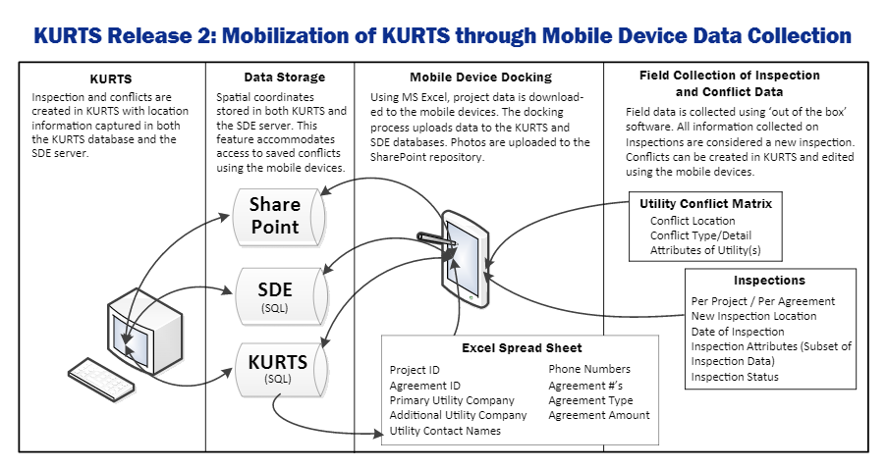
Mobile Device

Slide 27
R16 / EDC-3 Research
Challenge
Railroads must carefully evaluate transportation agency projects in terms of safety, engineering and operational impacts. For agencies, delays incurred while waiting for railroad reviews and agreements can increase project costs.
Solution
Improved Communication. A suite of tools helps public transportation agencies and railroads to identify and circumvent sources of conflict.
Expedited Project Delivery. MOUs developed for project and program needs can expedite delivery.

Slide 28
STIC Every Day Counts
Add Rail coordination into KURTS projects
Add Rail Safety and KRCI projects into KURTS
Complete tasks to improve system functionality and usability to promote data sharing

Slide 29
R16 - Railroad – DOT Mitigation Strategies
Develop updated master agreements with all Kentucky Rail companies
Enhance the Rail Crossing Inventory Database (RCI) to include necessary data to enhance rail coordination
Centralize all rail work into master agreements: rail coordination, Rail Safety Projects, and KRCI Projects

Slide 30
R16 - Railroad – DOT Mitigation Strategies
Kickoff regular coordination meetings with primary rail owners
Improve field data collection through updating the mobile application and hardware

Slide 31
R01A Research
Challenge
Utility data is frequently not stored in accessible formats so that it can be saved and reused for future projects, causing agencies to recreate the data.
Solution
SHRP2’s 3D storage and retrieval data model will accommodate large volumes of utility data, interface with existing design software, and provide a method for organizing the data so that it can reliably be used throughout the project design phase, during construction, and on future projects.

Slide 32
R01A – 3D Utility Location Data Repository
Develop a database to store and manage 2 and 3 dimensional utility location data
Seek out internal and external resources for data
Test the collection of 3-d utility location data in a pilot Project in D-3
Test the collection of utility location data on pilot permitted utility installations in D-3
Compare the value of vacuum excavation locations to RFID Marker ball technology
Identify implementation steps for future use

Slide 33
Questions?

